Slide 1
Application of Azure AutoML in Stock Price Timeseries Forecasting
Jason Xiao – Cloud Solution Architect
Azure AI & Analytics Team​
Notes:
*Introductions
Thank you for spending your precious time in the morning to listen to my presentation!
This presentation will be about the application of azure autoML in stock price timeseries forecasting, please feel free to stop my anywhere in the middle if you would like to clarify something or find something curious.

Slide 2
Scope:
Assess effectiveness of Azure AutoML in forecasting stock price time series.
Compare AutoML’s pros and cons with competing ML frameworks (Prophet).
Accuracy
Effort of Deployment
Explanability and Transparency
Technical Skill Requirement
Notes:
Before we go on, let me first talk a little bit about the scope of this project.
It was designed to help with personal upscaling and gaining familiarity with the Azure AutoML service. And as a typical attachment to all beginning of careers where students right out of college want to figure out how to invest their money. I thought it would be a very interesting topic to explore stock price forecasting, which is a problem facing many fintech companies and hedgefunds till this day.
The goal is to assess the effectiveness of azure automl in forecasting stock price time series.
And what it means to assess specifically, is we are going to compare Azure AutoML’s pros and cons with competing ML frameworks, in this case, Prophet.
The comparison metrics will be centered around:
1. Accuracy --- How accurately can these models forecast the future price of a stock?
2. Effort of Deployment --- How hard was it to deploy each of these models?
3. Explanability and Transparency --- How explainable were the models generated by each of the ML frameworks?
4. Technical Skill Requirement/Inclusivity. --- How friendly are these services for people with less technical capability?

Slide 3
Proposed Forecasting Architecture
Notes:
Onto the project itself.
We will use a consistent architecture for forecasting, with a minor difference in the ML service.
*Direct to Architecture diagram
We will be using the AlphaVantage API from a virtual machine to mine live stock price data for specific stock tickers to use in this project.
After data is pulled using AlphaVantage, we preprocess it on the virtual machine and then upload it as a csv file to blob storage.
The blob storage, is then can be linked up with Azure ML studio as a data store. This allows the csvs to be read into the ML studio as data used for analysis and can be easily used to start ML experiments.
Within AzureML studio, we run time series analysis experiments and ultimately generate a usable endpoint that can help forecast stock prices.
Same architecture applies for using Facebook Prophet as the forecaster

Slide 4
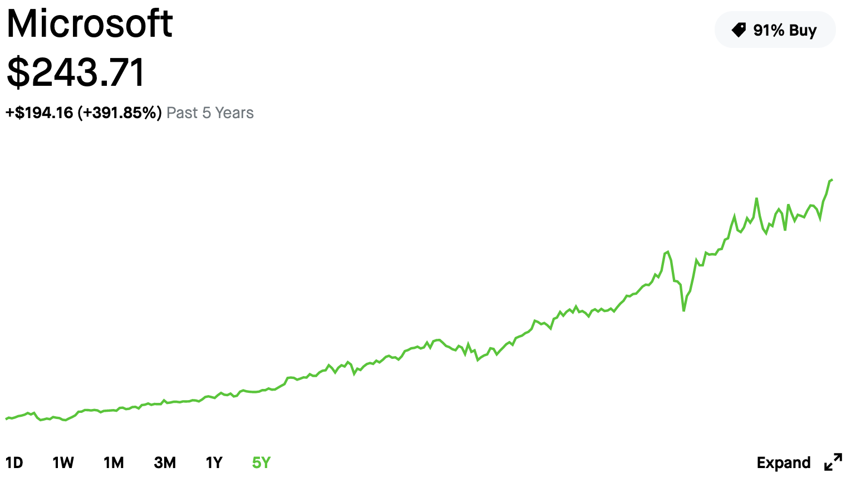
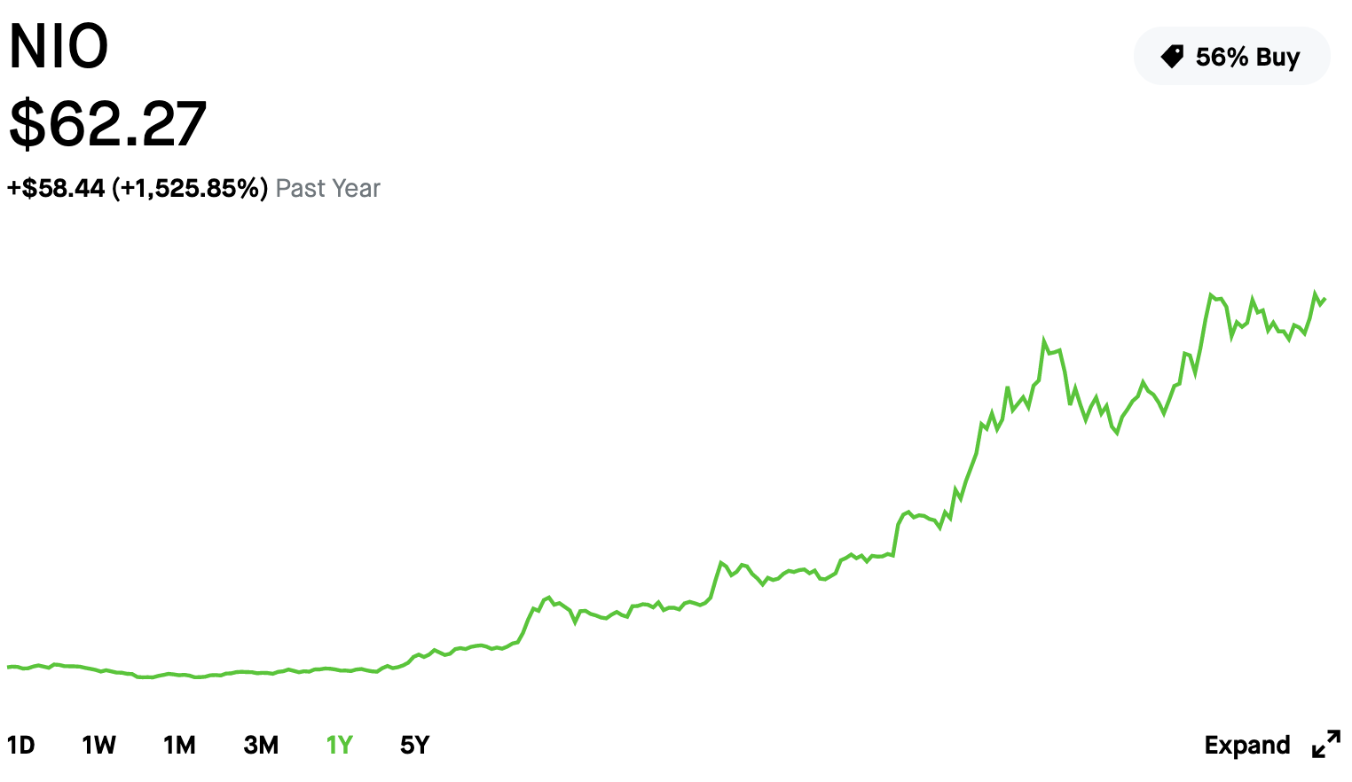
Stocks Involved
MSFT
NIO
Notes:
Discuss trend and volatility.
The two stocks I’ve decided to show case here is MSFT and NIO.
Everyone knows about our MSFT stock, which is said to be very consistent in trend and stability.
NIO on the other hand, has come to fame only recently, with its stock price sky rocketing more than 1500% over the last year. As of today, it’s stock price is still very volatile and subject to debate.
I wanted to see how well machine learning models can predict these volatile fluctuations (obviously with not much hope though, since the stock market is quite an unsolved mystery when constrained to data only related to the stock price.)
The data we use contains information about its open price, closing price, daily highs and lows and trading volumes of the stock.
To train on Azure AutoML, I’ve generated a lag of thirty days in the data myself during the preprocessing process to help the autoML forecaster predict stock prices 30days ahead given a point, hoping that it would.
Lets move on to see the result of forecasting MSFT’s stock price on AutoML.

Slide 5
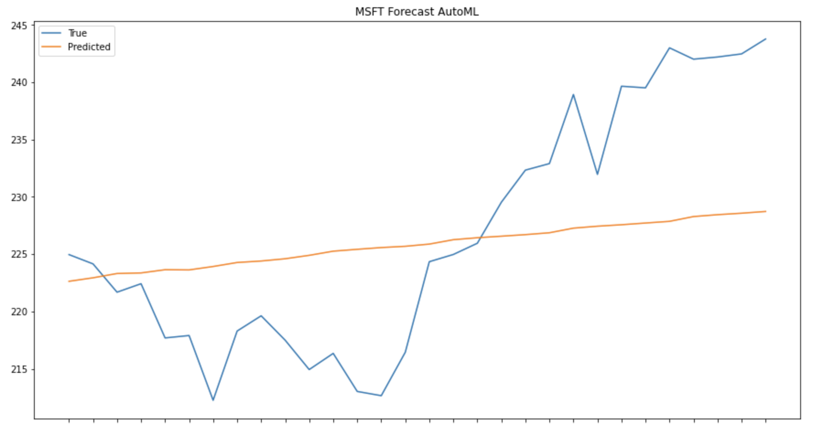
Results and Visualizations – AutoML
Notes:
This graph shows autoML’s auto ARIMA model’s forecasting results, it is generated via a artificial test set I created from preprocessing.
From a first glance we could see that the orange prediction line is quite flat. Over a short term of 30 days, it correctly predicts that the stock price goes up, but really doesn’t capture much of where the exact dips are. After a while, I realized that this is because the forecaster recognizes the stock’s implied volatility and thinks its trend generally is not too volatile. But it’s predictions definitely lack short term detail capturing skills.
Due to the fact that AutoML models are unable to trigger predictions responses of dates previous to the training data, its hard to see a bigger picture as well, which would come at the cost of reducing the size of your training set.
For example:
If I used data up to the end of 2020 to train the forecaster. I can only use data in the year 2021 or later as inputs for forecasting.
Now I’ll show you guys what happens when autoML takes in data that’s slightly more volatile.

Slide 6
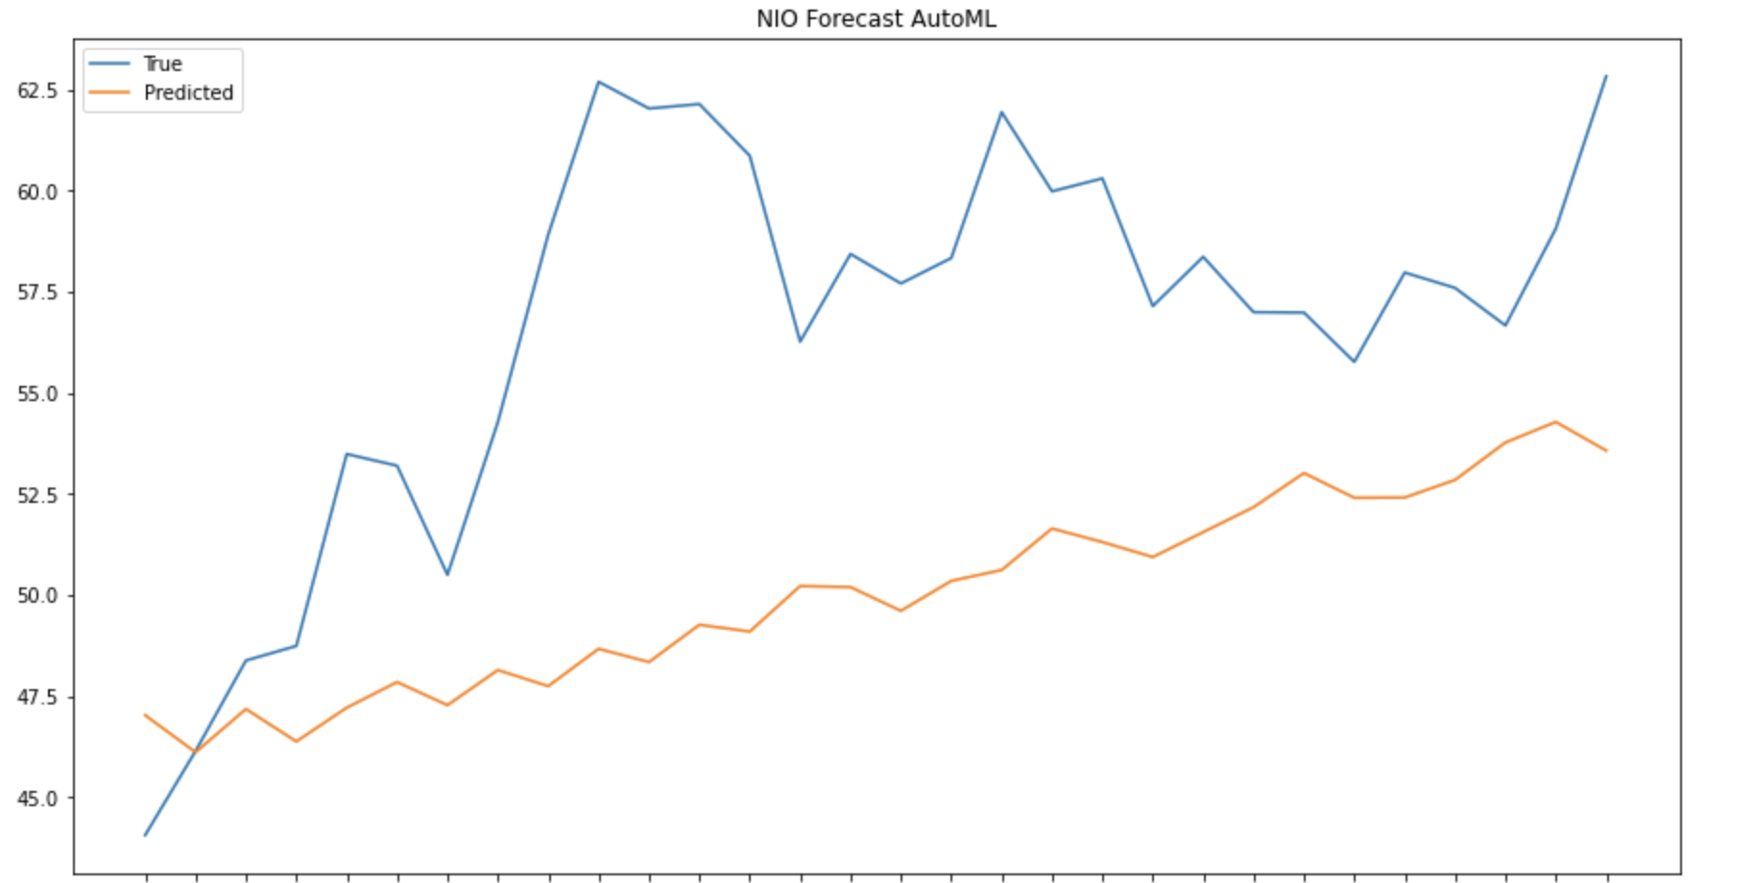
Results and Visualizations -- AutoML
Notes:
This is the results of AutoML time series forecasting on NIO’s stock price. We could see that its similar to the previous but much more jagged. I think this is because of the high volatility captured, where the model thinks the stock is much more volatile in comparison to MSFT. The trend is correctly captured as going up, but short term fluctuations are still hard to recognize.

Slide 7
Pros and Cons of Azure AutoML in Industry
Pros
Transparency
Scalability in Model Selection Process
Ease of use/Low skill requirement
Cons
Lacks flexibility in tuning specific models
Forecasting visualization surprisingly difficult
Notes:
*Discuss pros and cons
So to summarize the pros and cons of using Azure AutoML in time series forecasting:
Transparency is definitely a good to have --- Azure AutoML’s explainability feature can tell the user which feature the ML models prioritize, which could help users tune their data, and engineer more useful features.
Scalability in the model selection process --- Azure AutoML’s single experiment can train up to hundreds of different ML models and rank them based on their training/cross validation error.
Ease of use/low skill requirement --- Everything on Azure AutoML can be done without any coding experience. This enables a lot of customers who do not have coding experience to find it a viable choice. However, to AutoML to fully automate, eg. Where the training/generate experiment/select model process is all automated, code would be required. The AutoML SDK is capable of achieving that, but will definitely require skill in coding.
Some cons to using Azure AutoML:
It lacks flexibility in tuning specific models --- eg. If a customer were to have one very specific problem that is repeated required of high accuracy predictions. The scalability of the model selection process maybe less important in comparison to tuning the one specific model. In this case, Azure AutoML is best used for model selection only, and the model should be implement separately by someone with more ML capability. It is not necessarily a bad thing, but more so a limitation that would potentially narrow down the amount of customers that should be using Azure AutoML extensively. To extend this to a more tangible example applicable in industry, lets consider two cases. The first of which is a traffic control tower that simply wants to predict the amount of cars that will pass interstate 80 the next week. And the second is a small ecommerce company that wants to predict the sales of each of variety of products in each of its variety of stores. It would be clear that for the first scenario, we would want one model, that is extremely good at predicting the amount of cars on I80. In this case, autoML might come into play as telling you, during the process of training a few hundred models, we found that the ridge regressor or the auto Arima performed best. And then an ML expert should probably come in making a more customer ridge regressor or auto Arima model. Regarding the case of the e commerce company: for every different product at every store, it might need a different ML model, perhaps here the scalability of azure autoML’s model selection is best used and tuning per model to perfection is slightly unrealistic.
The visualization process of azure autoML is surprisingly difficult. As itself doesn’t have any visualizations built in for predictions and testing. However, that is a noted issue by the product team and I will be participating in a private preview regarding increased explainability and model visualization. It was supposedly early feb, later on they emailed me and said mid feb, hopefully it would be accessible before march.
Now let’s move on from azure and take a look at the performance of facebook’s prophet model.

Slide 8
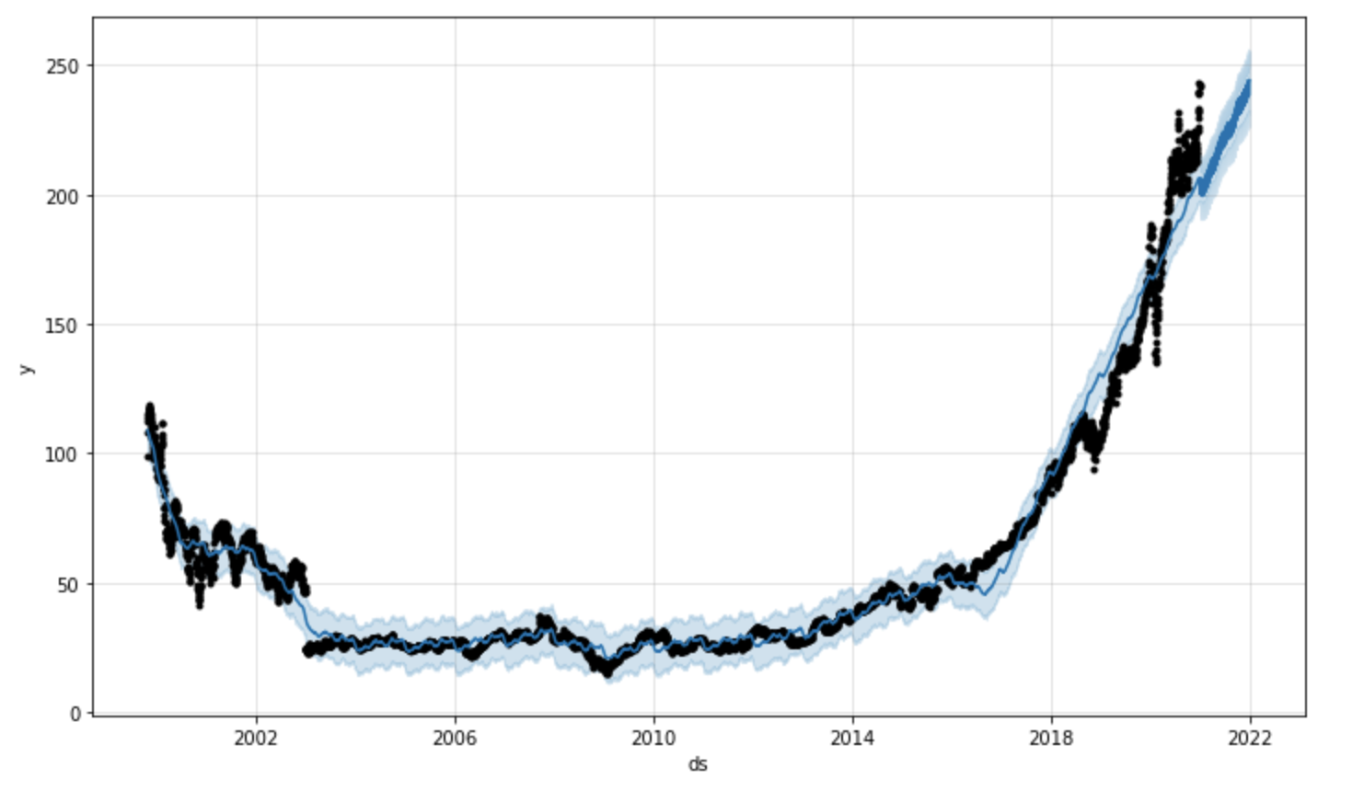
Results and Visualizations -- Prophet
MSFT
Notes:
This is the forecasting of facebook’s prophet model.
Although it seems to have a better fit from first look, it is because it takes a more aggressive approach to handle short term fluctuations. However, the accuracy is quite low, if we take closer looks at month level and numbers. The prophet API lacks sufficient documentation and control for the user, despite being pretty easily deployed for people with computer science backgrounds. There is not really a model explain feature, but one thing that’s nice is the variance range it provides. In the graph, the blue region surrounding the true stock price is the prophet forecaster’s idea of a potential range of where the stock price could be. Nearing the end, we could see that if we look at short term predictions, it is also quite off and not really fitting.

Slide 9
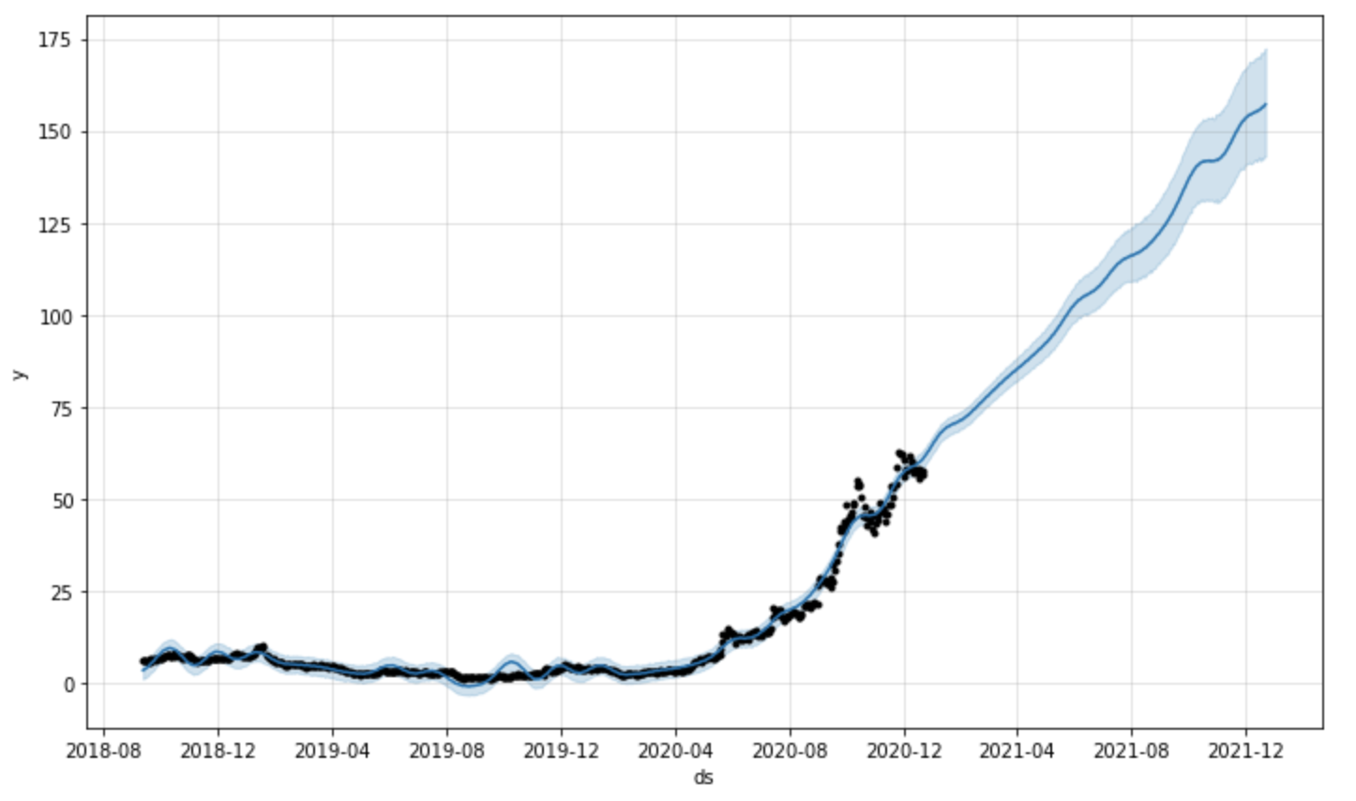
Results and Visualizations -- Prophet
NIO
Notes:
Similarly, this a prediction done on NIO. Prophet is capable of easily setting a forecasting window without the need to pre generate lag in the data. If we look at the last check of this graph, which is the same part as the training data we used for Azure AutoML, we could see that it also plotted a line straight through that doesn’t really capture short term fluctuations.
Comparing to Azure’s AutoML, prophet is a little bit better on the visualization part which comes automatically. But lacks Explanability and transparency in its model’s inner workings. Prophet also would require basic coding skills to implement.

Slide 10
Potential Expansions and Industry Applications
Supply chain optimization
Inventory forecasts
Sales forecasts
Supply forecasts
Predictive maintenance
Anomaly detection in timeseries data
Notes:
I’ve put some thought lately regarding what the supposed production level is for this project, and I thought it would include the full automation of data mining and forecasting to reduce human workload. This is achievable with a constantly running virtual machine. It could also include stock price anomaly detections – which could include expansion towards generating trading signals.
Along side those augmentations, the same architecture design can be tuned to many other industries and use cases. A few obvious ones would be supply chain optimization, which would require a ton of models for a ton of products in many distributions centers. It would help with inventory forecasts, sales forecasts, supply forecasts etc. This I totally gathered from my previous internship experiences.
Predictive maintenance is also a field which would require time series analysis/ anomaly detection.

Slide 11
Personal Upscaling and Learning – Next steps
Proficient at using Azure AutoML on topics related to Time Series Forecasting
Publication of the application of AutoML in Time Series Forecasting:
Transition github to public
Collect and brainstorm more use cases
Career direction discovery
Work with partners interested in time series forecasting
Participate in upcoming private previews, contribute to engineering efforts
Slowly become SME in areas of time series forecasting, with extension to but not limited to:
Supply chain optimization
Predictive maintenance
Fraud detection
Notes:
This slide is really a slide that I want to use to talk about how I’ve really appreciated the opportunity to work on this project, what I’ve learned, and what there is to do going forward.
First of all I feel that I’ve become much more proficient at using azure automl on topics related to time seires forecasting, this would not only improve my capability as a member on the azure AI team, but also give me greater confidence to present myself in front of customers who are interested in this topic.
Second of all, I am looking forward to publishing some of this project content in the form of a blog for people to see. If they are interested in conducting similar forms of time series analysis, or if they feel they have a use case that might require a similar architecture. This could also include transitioning the github of this project from private to public. I also aim to maintain this public content by updating it with potential new use cases, better models and etc.
Third, I feel that completing this project was a great way to begin a career direction discovery process, where I consolidate my interest in topics of time series forecasting. I’ve become interested in participating in upcoming private previews, and interested in contributing to engineering efforts related to time series analysis and autoML. I also hope to become a SME in time series forecasting with extension to but not limited to supply chain optimization, predictive maintenance, fraud detection and etc.

Slide 12
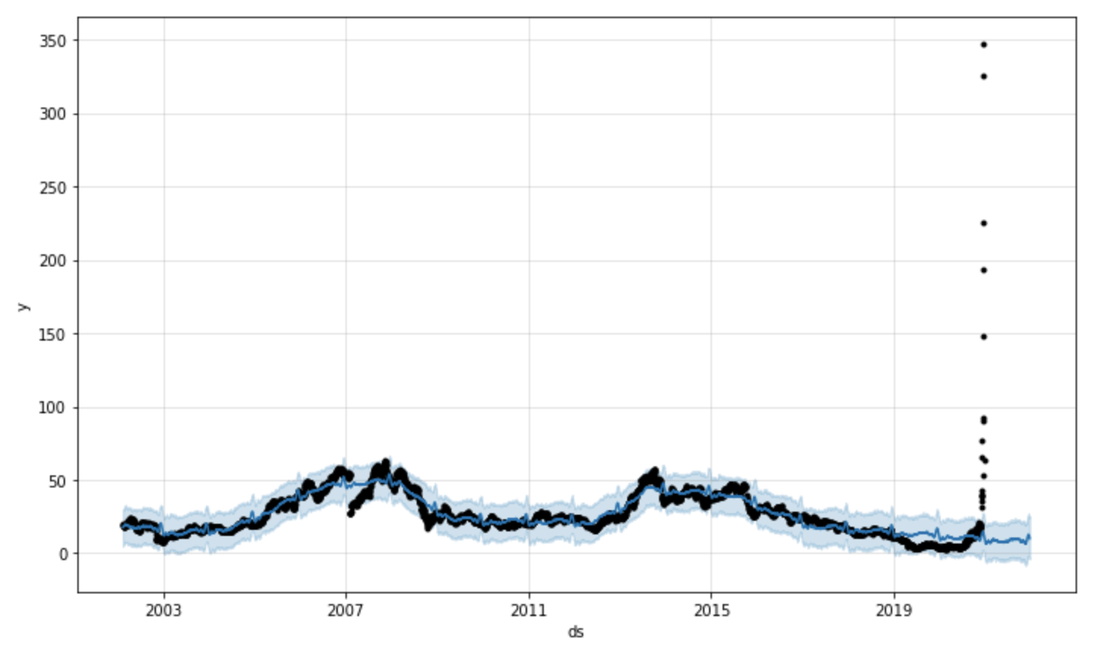
Just for fun -- Prophet
Notes:
This is a blooper slide where I tried to give game stop stock a little forecast. It seems that the forecaster does think the stock is going to the moon.

Slide 13
Feedback and Comments
Notes:
Thank you guys so much for listening in to my presentation and giving your precious time. It would be great to hear some of your feed back or questions, and I will take note of them and make improvements. Especially before the publishing of this content. Thanks again ☺

